Slide 1

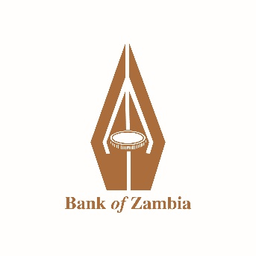
Monetary Policy Committee Statement for the Second Quarter of 2026
Governor’s Presentation to the Media
September 30, 2026

Slide 2
Outline of Presentation
  Decision of the Monetary Policy Committee
  Inflation Outturn and Outlook
  Foreign Exchange Market
  Gross International Reserves
  Current Account
  Credit Developments
  Government Securities Market
  Recent Economic Activity
  Real GDP Growth Outlook
  Key Takeaways

Slide 3
Decision of the Monetary Policy Committee
At its September 28-29, 2026 Meeting, the Monetary Policy Committee decided to reduce the Monetary Policy Rate by 250 basis points to10.75 percent.
In arriving at this decision, the Committee took into account the following:
  Lower inflation outcome and projection;
  Identified upside risks to the inflation outlook; and
  The need to align the monetary policy stance with the improved inflation outlook, which is expected to support growth.

Slide 4
Inflation Outturn
Inflation has continued to trend downwards and is now firmly in the 6-8 percent target band (Table 1 and Chart 1).
Table 1: Quarterly Average and end-Period Inflation (percent)
 | 2025Q2 | 2025Q3 | 2025Q4 | 2026Q1 | 2026Q2 | 2026Q3
Average
Overall Inflation | 15.3 | 12.6 | 11.3 | 8.0 | 6.6 | 6.3
Food Inflation | 17.7 | 14.9 | 13.6 | 9.0 | 7.0 | 6.1
Non-Food Inflation | 11.8 | 9.3 | 8.0 | 6.6 | 6.0 | 6.6
End-Period
Overall Inflation | 14.1 | 12.3 | 11.2 | 7.1 | 6.5 | 6.1
Food Inflation | 16.7 | 14.6 | 12.9 | 7.8 | 6.7 | 5.8
Non-Food Inflation | 10.3 | 9.0 | 8.7 | 5.9 | 6.0 | 6.6
Source: Bank of Zambia and Zambia Statistics Agency

Slide 5
… cont’d
Overall inflation declined to 6.5 percent in June from 7.1 percent in March 2026. It has declined further to 6.1 percent in September (Chart 1).
Key drivers have been lower maize grain prices and the continued appreciation of the exchange rate, supported by a relatively tight monetary policy stance and fiscal consolidation.
Chart 1: Trends in Monthly Inflation (year-on-year percent)
Source: Bank of Zambia and Zambia Statistics Agency

Slide 6
… cont’d
Chart 2: Contribution to Food Inflation by Sub-Group (percentage points)
Chart 3: Contribution to Non-Food Inflation by Sub-Group (percentage points)
Source: Zambia Statistics Agency, Bank of Zambia Staff Computations
Source: Zambia Statistics Agency, Bank of Zambia Staff Computations

Slide 7
Inflation Outlook
Inflation is projected to remain within the 6–8 percent target band over the forecast horizon (2026Q3-2028Q2).
Annual average inflation is projected at 6.7 percent in 2026 and 6.0 percent in 2027, before edging up to 6.3 percent in the first half of 2028 (Chart 4 and Table 2).
Key factors underpinning the current outlook are:
  Anticipated stable maize grain prices; and
  Lagged impact of the appreciation of the Kwacha/US$ exchange rate.
The risks to this outlook remain on the upside. They include the expected super El Niño conditions, protracted conflict in the Middle East and geopolitical tensions in general, and tighter global financial conditions.
    Chart 4: Inflation Projection (percent)
Table 2: Inflation Projection (average percent)
 | 2026 | 2027 | 2028
August-26 Projection | 6.7 | 6.0 | 6.3*
May-26 Projection | 6.8 | 6.1 | n/a
Source: Bank of Zambia and Zambia Statistics Agency

Slide 8
Foreign Exchange Market
The Kwacha continued to appreciate against the US dollar in the second quarter, albeit at a slower pace than in the first quarter. It gained by 8.3 percent compared to 14.8 percent in the previous quarter (Chart 5). This reflected continued supply by the mining sector.
Despite the Kwacha depreciating against the US dollar by 5.6 percent so far in the third quarter (September 28), it has appreciated by 11.8 percent on a year-to-date basis.
Chart 5: Nominal K/US Dollar Exchange Rate
Source: Bank of Zambia

Slide 9
… cont’d
Chart 6: US Dollar Index and MSCI Emerging Markets Index (monthly average)
Chart 7: Performance of Selected Emerging Market and Developing Economies Currencies versus the US Dollar in the Second Quarter of 2026 (percent)
Source: Reuters and Bank of Zambia Compilations
Source: Reuters and Bank of Zambia Compilations

Slide 10
… cont’d
In the second quarter, net foreign exchange sales by mining companies increased to USD774.0 million from USD626.0 million while tax remittances to the Bank of Zambia were USD398.7 million (Chart 8).
Together, these inflows raised total foreign exchange liquidity supplied by the mining sector to USD1.2 billion from USD0.9 billion in the first quarter (Chart 8).
Chart 8: Net Foreign Exchange Inflows from the Mining Sector (USD Million)
Source: Bank of Zambia

Slide 11
… cont’d
Foreign financial institutions contributed USD132.1 million to market supply in the second quarter, down from USD542.3 million in the first quarter.
Reduced supply by foreign financial institutions was due to the exhaustion of their allocation in the primary market for Government securities.
As a result, the market shifted to net demand of USD119.1 million in the second quarter from net supply of USD230.2 million in the previous quarter (Chart 9).
Chart 9: Sectoral Net Sales (+)/Purchases (-) of Foreign Exchange (USD Million)
Source: Bank of Zambia

Slide 12
… cont’d
The Bank provided USD72.0 million in market support to manage exchange rate volatility.
This notwithstanding, the Bank continued to be a net buyer of foreign exchange, mostly through taxes remitted by mining companies (Chart 10).
Chart 10: Bank of Zambia Foreign Exchange Transaction (USD Million)
Source: Bank of Zambia

Slide 13
… cont’d
Interbank foreign exchange market activity reduced in the second quarter. The turnover declined to USD375.7 million from USD396.5 million (Chart 11).
Chart 11: Turnover in the Interbank Foreign Exchange Market (USD Million)
Source: Bank of Zambia

Slide 14
Gross International Reserves
At end-June, gross international reserves declined to USD5.8 billion equivalent to 4.4 months of import cover, from USD6.2 billion (5.2 months of import cover) at end-March, having reached US$6.5 billion equivalent to 4.9 months of import cover at end-May (Chart 12).
The bond buyback operation (USD514.8 million) in June and external debt service (USD453.4 million) contributed to the decline in reserves.
In July, reserves picked up to USD6.0 billion (equivalent to 4.5 months of import cover) mainly on account of mining taxes (USD88.3 million), project inflows (USD14.5 million), Government non-tax receipts (USD13.6 million), interest on reserves (USD13.0 million), and monetary gold purchases (USD8.5 million).
In July, 62.21 kg worth USD8.2 million was bought, bringing the total holdings to 3,620.43 kg with market value of USD468.7 million since the Bank embarked on purchasing locally produced gold in December 2020.
As of September 29, the average price of gold was USD4,160.00 per ounce.
Chart 12: Gross International Reserves (USD Billion)
Source: Bank of Zambia

Slide 15
Current Account
The current account surplus widened to USD0.3 billion (3.2 percent of GDP) in the second quarter from USD0.1 billion (0.8 percent of GDP) in the preceding quarter (Chart 13).
The key drivers were strong growth in net exports, lower reinvested earnings by foreign-owned companies, and higher remittances mostly from the US, UK and South Africa.
Traditional exports, comprising exclusively of copper, rose by 3.7 percent to USD3.1 billion.
While non-traditional exports increased by 31.7 percent to USD1.5 billion, driven by nickel ores, sulphur, burley tobacco, and gemstones.
Chart 13: Current Account Balance (USD Billion)
Source: Bank of Zambia

Slide 16
Credit Developments
Overall domestic credit growth expanded by 14.4 percent in June compared to 7.5 percent in March (Chart 14).
Over the same period, private sector credit expanded by 12.9 percent compared with 8.1 percent due to debt refinancing and working capital requirements.
Public sector credit also expanded to 16.0 percent from 6.6 percent mainly due to the Liquidity Management Operation relating to the 2053 Eurobond buyback.
Chart 14: Contribution to y/y Domestic Credit Growth
Source: Bank of Zambia
Notes:
Overall Domestic Credit
In nominal terms, overall credit reduced to K214,072.9 million in March 2026 from K215,159.1 in December 2025.
Public sector credit
Under the public sector credit, Government obtained foreign currency loans under the undertook Liability Management Operation in the second half of 2025 to clear fuel arrears. Consequently, government exposure reduced in March 2026 due to valuation effects.

Slide 17
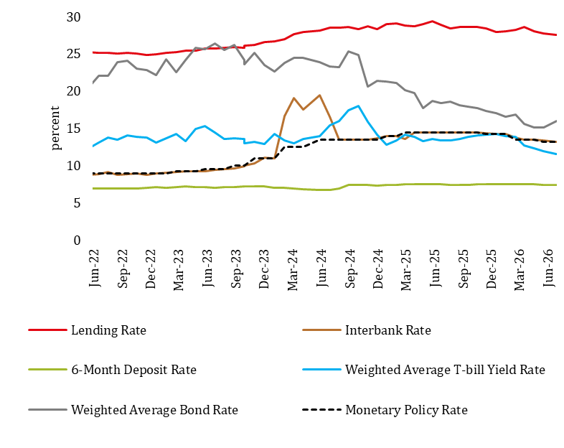
Interest Rate Movement
Nominal interest rates generally declined due to the reduction in the Policy Rate, supported by improved liquidity conditions. The yield rate on Government bonds increased marginally on account of subdued demand for long-term instruments (Chart 15).
Chart 15: Average Nominal Interest Rates (percent)
Source: Bank of Zambia
Notes:
Overall Domestic Credit
In nominal terms, overall credit reduced to K214,072.9 million in March 2026 from K215,159.1 in December 2025.
Public sector credit
Under the public sector credit, Government obtained foreign currency loans under the undertook Liability Management Operation in the second half of 2025 to clear fuel arrears. Consequently, government exposure reduced in March 2026 due to valuation effects.

Slide 18
Government Securities Market
Total outstanding Government securities stood at K270.7 billion at end-June 2026.
Demand for Treasury bills was stronger than that for Government bonds. This is reflected in average subscription rates of 107.8 percent compared to 61.7 percent.
Investor appetite for Treasury bills was supported by favourable money market liquidity conditions while limited non-resident participation and the reduction in bond auctions to two per quarter from monthly could have constrained demand for bonds.
In June, holdings of Government securities by non-resident investors reduced by K0.1 billion to K78.2 billion (Chart 15). This represented 28.9 percent of the total outstanding stock (Chart 16).
Chart 16: Government Securities Holdings by Non-Resident Investors (K’ billions)
Source: Bank of Zambia

Slide 19
… cont’d
Yield rates on both Treasury bills and Government bonds have maintained a downward trend since September 2024. In June this year, The T-bill yield rate was 11.5 percent and currently stands at 10.8 percent (Chart 17).
Similarly, the bond yield rate fell to 16 percent in June this year and is currently at 15.2 percent.
Underlying the downward trend is mainly strong investor demand, particularly after raising non-resident participation in the primary market this year, and improved liquidity conditions.
Chart 17: Yield rates on Government Securities (percent)
Source: Bank of Zambia

Slide 20
Recent Economic Activity
The economy expanded by 7.2 percent in the second quarter, driven by ICT, agriculture, construction, and mining (Chart 18).
Chart 18: Quarterly Real GDP Growth Forecast (percent, y/y)
Source: Zambia Statistics Agency

Slide 21
… cont’d
Business conditions for the private sector are assessed to have remained favourable in the second quarter based on the average Stanbic Bank Zambia (PMI) reading of 50.1 (Chart 19).
This was reflected in input purchases and inventory accumulation.
Chart 19: Purchasing Manager’s Index for Zambia
Source: Stanbic Zambia and Bank of Zambia Compilations

Slide 22
… cont’d
Similarly, the July 2026 Bank of Zambia Quarterly Survey of Business Opinions and Expectations points to favourable business conditions during the second quarter (Chart 20).
Firms cited the decline in inflation, sustained exchange rate stability, and reliable electricity supply as key factors for improved business conditions.
Consequently, output, new orders, labour demand, and capacity utilisation increased on both year-on-year and quarter-on-quarter basis, and remained above their historical averages (Chart 20).
Chart 20: Business Opinion Response Patterns
Source: Bank of Zambia

Slide 23
Real GDP Growth Outlook
Despite the growing risk of El Niño conditions and continued uncertainty surrounding the conflict in the Middle East, domestic growth prospects remain favourable (Chart 21).
Real GDP growth is projected at 5.3 percent in 2026, 6.0 percent in 2027, and 7.1 percent in 2028 (Chart 21).
Growth is expected to be driven mainly by agriculture, mining, manufacturing, construction, as well as transport and storage sectors.
Chart 21: Real GDP Growth – Actual and Projected (percent)
Source: Zambia Statistics Agency, Bank of Zambia (BoZ), Ministry of Finance and National Planning (MoFNP), IMF, Focus Economics

Slide 24
Key Takeaways
At its September 28-29, 2026 Meeting, the Monetary Policy Committee decided to reduce the Monetary Policy Rate by 250 basis points to10.75 percent.
In arriving at this decision, the Committee took into account the following:
  Lower inflation outcome and projection;
  Identified upside risks to the inflation outlook; and
  The need to align the monetary policy stance with the improved inflation outlook, which is expected to support growth.

Slide 25
THANK YOU FOR YOUR ATTENTION.
GOD BLESS…

